Slide 1
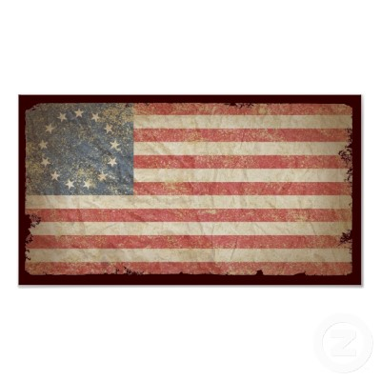
The 13 Colonies
Miss Natalie

Slide 2
Where are they exactly???

Slide 3
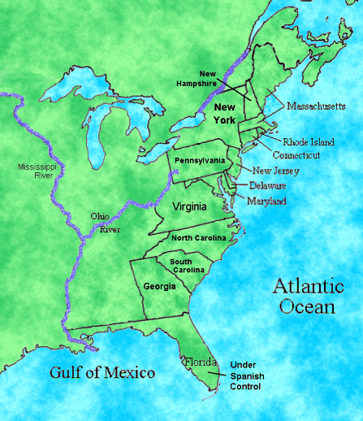
Three Geographic Regions
New England
Middle
Southern

Slide 4
So what was life really like in the colonies?
1. Population Boom
2. Economic Opportunities
3. Better health, sometimes!
4. Cheap Land
5. High Wages
6. Less Taxes
7. English Protection

Slide 5
Climate in the Colonies
In the thirteen colonies the climate changes in a north to south direction.
The coldest temperatures and shortest growing seasons were in the north and temperatures and growing seasons increased as you traveled down the coastline.

Slide 6
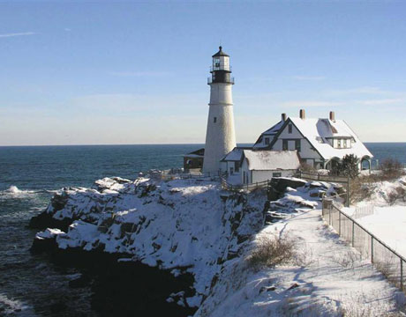
Compare: Winter in Maine and in Georgia

Slide 7
The New England Colonies
Colonies: The four original New England Colonies were : New Hampshire, Massachusetts, Connecticut, and Rhode Island
People: The people who settled and lived in the New England Colonies were from England.
Economies: Farming in the New England Colonies was difficult due to the poor soil, cold climate and short growing season. Families in New England grew enough food to feed their families but had to rely on manufacturing and trade to earn livings.

Slide 8
The New England Colonies
Climate: The Climate in the New England colonies was colder than the other two regions due to the northern location.
Geography: The geography of New England was mostly hills and rocky soil.
Natural Resources: The natural resources of New England were fish, whales, trees, and furs.
Religion: The established religion of the New England Colonies was Puritan. The Puritans were very strict moralists and did not tolerate others who believed differently. Religious freedom did not exist in New England.

Slide 9
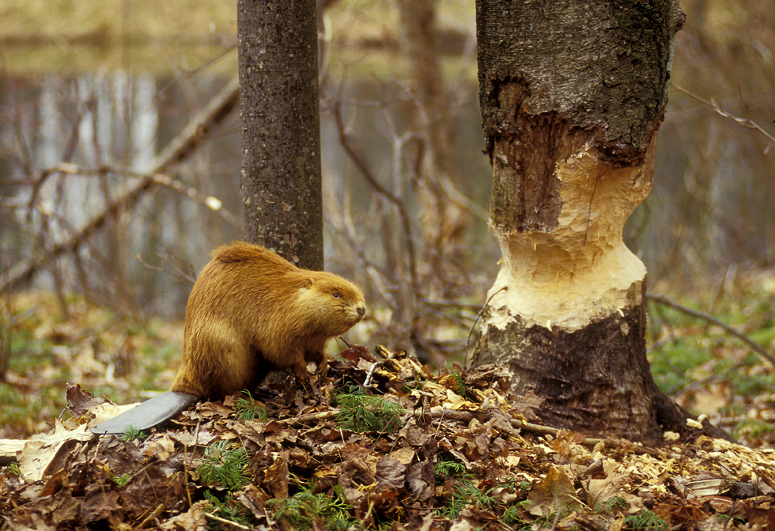
BEAVERS!

Slide 10
The Middle Colonies
Colonies: The Middle Colonies consisted of Delaware, Pennsylvania, New Jersey, and New York.
People: The Middle Colonies were the most ethnically and religiously diverse of the thirteen original colonies because of the influence of their Polish, English, Dutch, French and German origins.
Climate: The climate in the Middle Colonies was relatively hot. This allowed for a longer growing season. It was warmer than its northern counterpart New England but cooler than the Southern colonies

Slide 11
The Middle Colonies
Geography: The geography of the middle colonies was made up of hills and flat lands with good soil.
Natural Resources: The natural resources of the middle colonies were iron ore and good soil.
Religion: there was more religious freedom and tolerance. Many who had established colonies in the middle region were fleeing persecution in Europe or the strict New England Colonies.
The Middle colonists were a mixture of religions, including Quakers (led by William Penn), Catholics, Lutherans, Jews, and others.

Slide 12
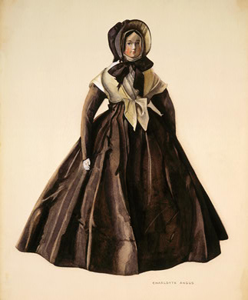
What does a Quaker look like? THIS:

Slide 13
The Southern Colonies
Colonies: In contrast to the New England and middle colonies were the rural southern colonies of Virginia, Maryland, North Carolina, South Carolina, and Georgia
People: The populations in the southern colonies were diverse and consisted of many European nationalities.
Climate: The climate in the southern colonies was the warmest of the three regions and boasted the longest growing season.

Slide 14
The Southern Colonies
Geography: The geography of the Southern Colonies which had a broad, coastal plain that was hilly and covered with forests.
Natural Resources: The natural resources found in the south were the rich farm lands, forests, and fish.
Religion: Religion had a very insignificant role Colonies in the south were established for profit rather than for religious freedom,
The Southern colonists had a mixture of religions including Baptists and Anglicans.

Slide 15
Rural Agriculture in the Southern Colonies

Slide 16
Economies of the Colonies: New England
New England’s economy centered on manufacturing.
Agriculture was difficult and unprofitable in the north due to poor soils, cold temperatures, and the short growing season.
Manufacturing in New England focused on shipbuilding due to the abundance of lumber. Trade in New England was mainly exporting the goods that they produced.

Slide 17
Economies of the Colonies: Middle Colonies
Agriculture had a large role in the economies of the Middle Colonies.
The middle region had better soils, warmer temperatures, and a longer growing season. The Middle Colonies agriculture produced corn, vegetables, grain, fruit, and livestock.
Manufacturing in the middle region was focused on iron ore products.
The Middle Colonies both exported agricultural products and natural resources and imported manufactured goods.

Slide 18
Economies of the Colonies: Southern Colonies
The Southern Colony’s economy was based solely on agriculture. The south has exceptional farming soil, warm climates and a long growing season.
The agriculture practiced in the region was Plantation Agriculture, focusing on one or two cash crops.
The southern region had no manufacturing so all goods needed were imported or bought from traders.

Slide 19
Economies of the Colonies
Widening trade networks (by ships, wagons, rivers, oceans) made it possible to connect people living further inland to the major coastal major trade centers
Although local production still met most needs, more and more the idea of purchasing new goods from far away made farmers want to grow crops to sell at market and not just for at home

Slide 20
Population Growth in the Colonies
While in Europe, population was growing gradually (1700 England= 5.1 million, 1750 England= 5.8 million)
Colonial population in the English colonies EXPLODED- from 260,000 to nearly 1.2 million!!!
This population was also shifting AWAY from just being colonists of English origin, as people from western Africa, other European countries, and eastern North America mixed together!

Slide 21
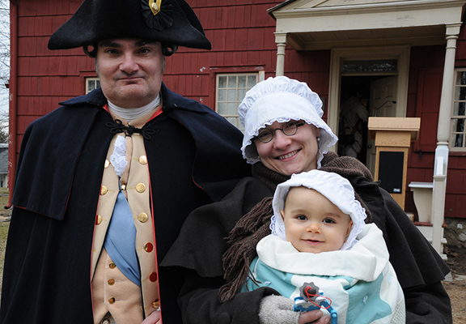
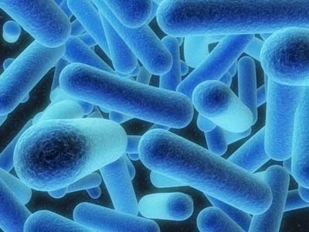
Why the Population Explosion???
High birth rate
Low death rate
Long average life span
No huge urban centers for
diseases to spread
Food was plentiful
Housing was improving
IMMIGRATION
(both forced and free)

Slide 22
Back Home in England…
Remember England was having problems with its monarchy, and at one time it was abolished? - Well, it was. But not for long:
King Charles II took over after the monarchy was restored
Charles started rewarding his supporters with land in the colonies -example: North and South Carolina, New York, New Jersey

Slide 23
Controlling Colonial Trade
Besides giving out land in America to his buddies, King Charles wanted to CONTROL the trade in the colonies to benefit the crown and England
What is this called?!?!!?

Slide 24
MERCANTILISM:
Write a definition for this in your notes!
Goal for the mother country to keep a favorable balance of trade: export more than it imports
- you could only do this if your country was self-sufficient and had access to cheap raw materials (from colonies)

Slide 25
Mercantilism Continued:
-The merchant class was in support of this policy, and had influence in English parliament → which led to things like the Navigation Acts of 1660
Colonists do not like to be controlled, especially when it comes to trade and their money!

Slide 26
The Glorious Revolution (in England)
King James II takes over the throne, -but he’s Catholic and very bossy (rules by decree and Parliament doesn’t like this) -tries to tighten control on colonies especially New England
1688: BLOODLESS REBELLION, THE GLORIOUS REVOLUTION!

Slide 27
THE REVOLUTION CONTINUED:
Protestant opposition invited the King’s daughter Mary and her Dutch husband to take the throne → James II flees to France
Parliament passes the Bill of Rights in 1689 to prevent any future abuses of power - lists rights and liberties for citizens and Parliament including free elections and not taxing without permission from Parliament

Slide 28
Write your answer down in your notebook:
WHY MIGHT THIS BILL OF RIGHTS BE IMPORTANT FOR THE COLONISTS LATER ON?!?!?!?!

Slide 29
Back in the Colonies…
New intellectual and religious ideas are transforming colonial life!
-The Enlightenment
-The Great Awakening
-Reactions to those movements

Slide 30
The Enlightenment
The revolution established the idea that royal power came from Parliament, not from God.
In Europe in the 1700s, a revolution of ideas was happening called-
THE ENLIGHTENMENT: the intellectual movement of the 18th century that rejected traditional political, social, and religious ideas and emphasized human reason and progress

Slide 31
The Great Awakening
Not everyone agreed with the ideas of the Enlightenment, and instead turned back to religion. This reaction was called:
The Great Awakening: the period of religious revival that swept through the colonies in the mid 18th century
-Jonathan Edwards – Began it
Preached Sermons with “Fire and Brimstone” and God is to be Loved AND Feared
-George Whitefield –
Went around country several times preaching to massive crowds

Slide 32
Yet Another Reaction
As a reaction to the ideas of the Great Awakening, other ministers in the colonies called the revivalists, started to preach to ordinary colonists about equality of everyone before God - (appealing to many people including women and slaves)
IN GENERAL, all of this religious upheaval with the Great Awakening and its reactions was challenging the established religious authority of England.

Slide 33
NORTH AMERICA RIVALRY: England v. France
England has:
1. Great Navy
2. Large Population (2 Million in the colonies)
3. Varied Economy
4. Iroquois Confederacy Ally
France has:
1. Army with better leaders
2. Less fighting amongst themselves
3. Native Am allies
Major French Problem = Low # of permanent settlements in large areas

Slide 34
3 Major Wars
1. King Wm.’s War (1689 – 1697)
2. Queen Anne’s War (1701 – 1713)
3. King George’s War (1738 – 1748)
All involve England vs. France
All end in a draw
Little was achieved – but sets stage for the Fr and Indian War (“Seven Years War”)

Slide 35
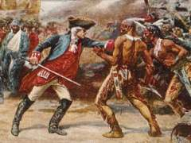
French and Indian War
Background:
About 2 million British
colonists in America, 65,000
French in Canada
This war began in the colonies,
not in Europe
Ohio River Valley- contested land, is it Native American, British, or French????

Slide 36
Colonists vs. Native Am (1750)
Despite “Great Awakening,” Colonists ready to kill French and Native Americans
George Washington – One of the 1st to do so
England given 500,000 acres in Ohio River Valley – but France builds forts in the area (Lines between Canada and Louisiana)

Slide 37
French and Indian War Continued
1754 Washington with 150 men enter area Open Fire, French refuse to leave the area
French and Indian War Begins!
French flee and attack Fort Necessity and win(Washington and men go home)

Slide 38
The Albany Plan
Albany, New York (1754)
Albany Plan of Union- English Gov’t met with colonies to see if they would unify against France
Also want Iroquois to join alliance against France
English Plan = Beat France and control the continent
Ben Franklin- Saw Albany Plan as way to increase economic & Political Power
Outcome = Representatives pass it; however, colonies reject it because it would give up too much INDEPENDENCE!

Slide 39
Treaty of Paris (1763)
Outcomes:
1. French defeated
2. France loses access to Great Lakes (Fishing and Trading)
Officially ends French and Indian War
England gets:
1. All of Canada
2. All of America East of Mississippi River (England gives all area West of it to France)
3. Florida
4. Some Caribbean Islands

Slide 40
Native Americans
After French and Indian war, can no longer play the French off the British in order to stop the advancement of settlers on their lands
Once British had control of Ohio territory, they reduced the prices they would pay for furs, allowed settlers to take Native American land without payment, and built forts in violation of treaties with local tribes.

Slide 41
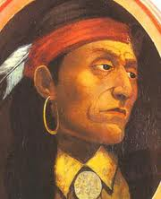
Pontiac’s Rebellion
Native American Ottawa Chief, Pontiac, led a major rebellion in 1763-
attacking forts in Indiana, Michigan, Wisconsin, and Pennsylvania, and killing more than 2,000 settlers
but without help from the French, the rebellion is put down by the end of the year.

Slide 42
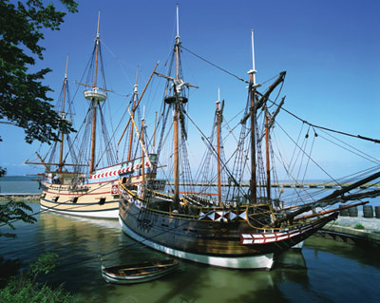
Consequences of the War
British debt jumps from 75 million to 137 million pounds (British think colonists should have to help pay this)
Colonial smuggling during the war was a problem, so British wanted to crack down on this
British worried about settling new land and causing more conflict (like Pontiac’s rebellion)
All of this leads to a series of British policies in the 1760s…

Slide 43
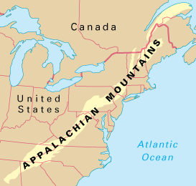
Proclamation of 1763
Restricted settlement west of the Appalachian mountains
Stationed British naval ships to seize colonist merchants suspected of smuggling and illegal trading
Also, a series of taxes were raised:
-Sugar Act of 1764 -Quartering Act of 1765
-Stamp Act of 1765

Slide 44
Changing Attitudes Toward England
As time goes on, American feelings for England begin to Change
Early Reasons:
1. Arrogant, Stubborn English Leaders
2. America was Growing Up (“Not a Baby Anymore”)
3. Begin to think of America and its colonists not as people but as THINGS!

Slide 45
Factors Leading to “Declaration of Independence”
1. Mercantilism
2. Proclamation of (1763)
3. Sugar Act (1764)
4. Stamp Act (1765)
5. Townshend Acts (1767) (taxes on imported goods)
6. 4,000 British Troops in Boston
7. Boston Massacre (1770)
8. Tea Act (1773)
9. Coercive/ Intolerable Acts (1774) (includes the Quartering Act, Closing Port of Boston…)

